Slide 1
Barbell Portfolio
By Mykyta Medvediev, 2022

Slide 2
Table of contents
Background
Asset allocation
Calculations
Hypothesis testing
Conclusions

Slide 3
Background

Slide 4
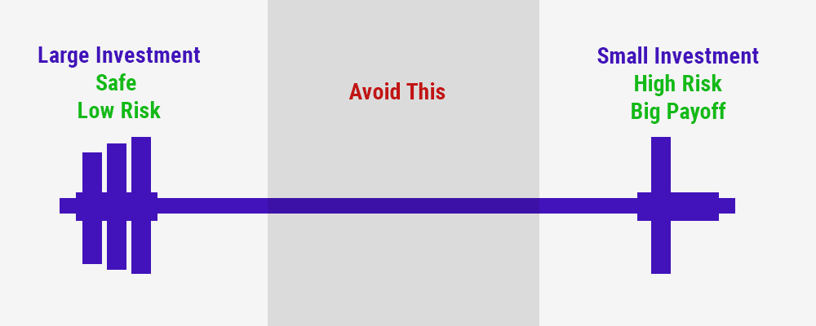
Background

Slide 5
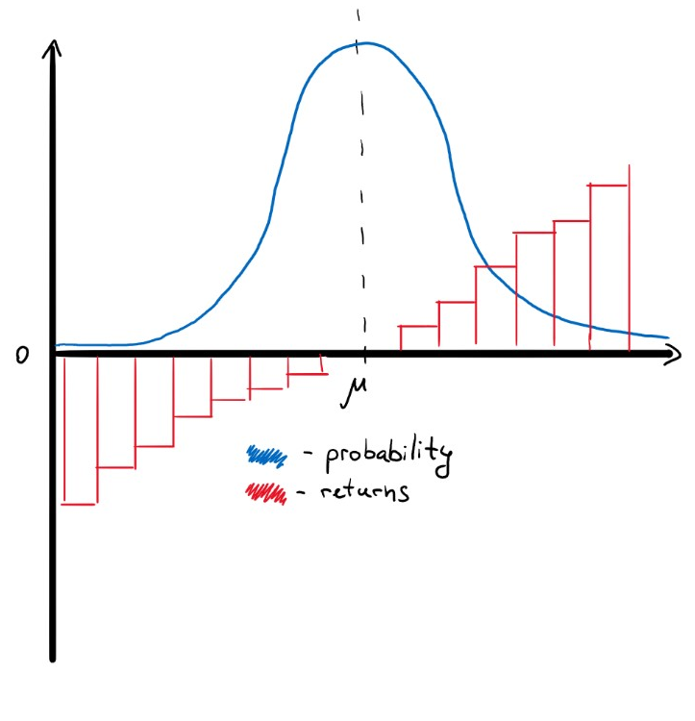
Background
Normal distribution

Slide 6
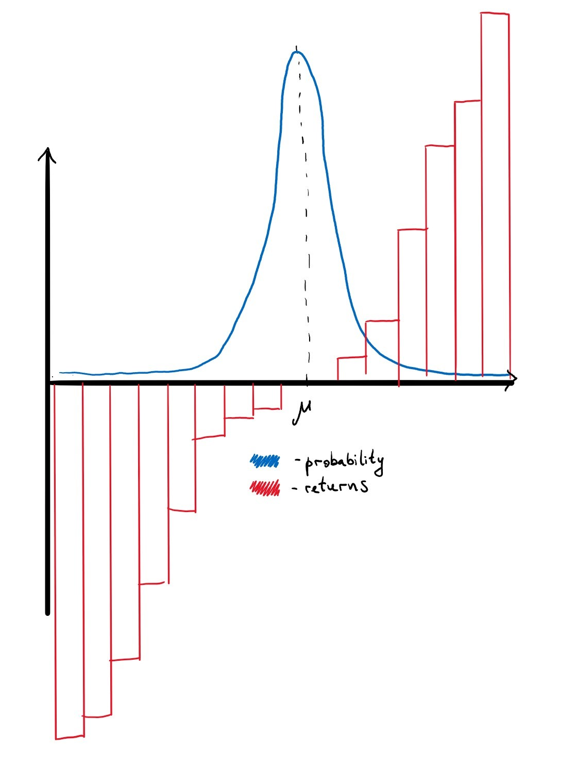
Background
Fat tails

Slide 7
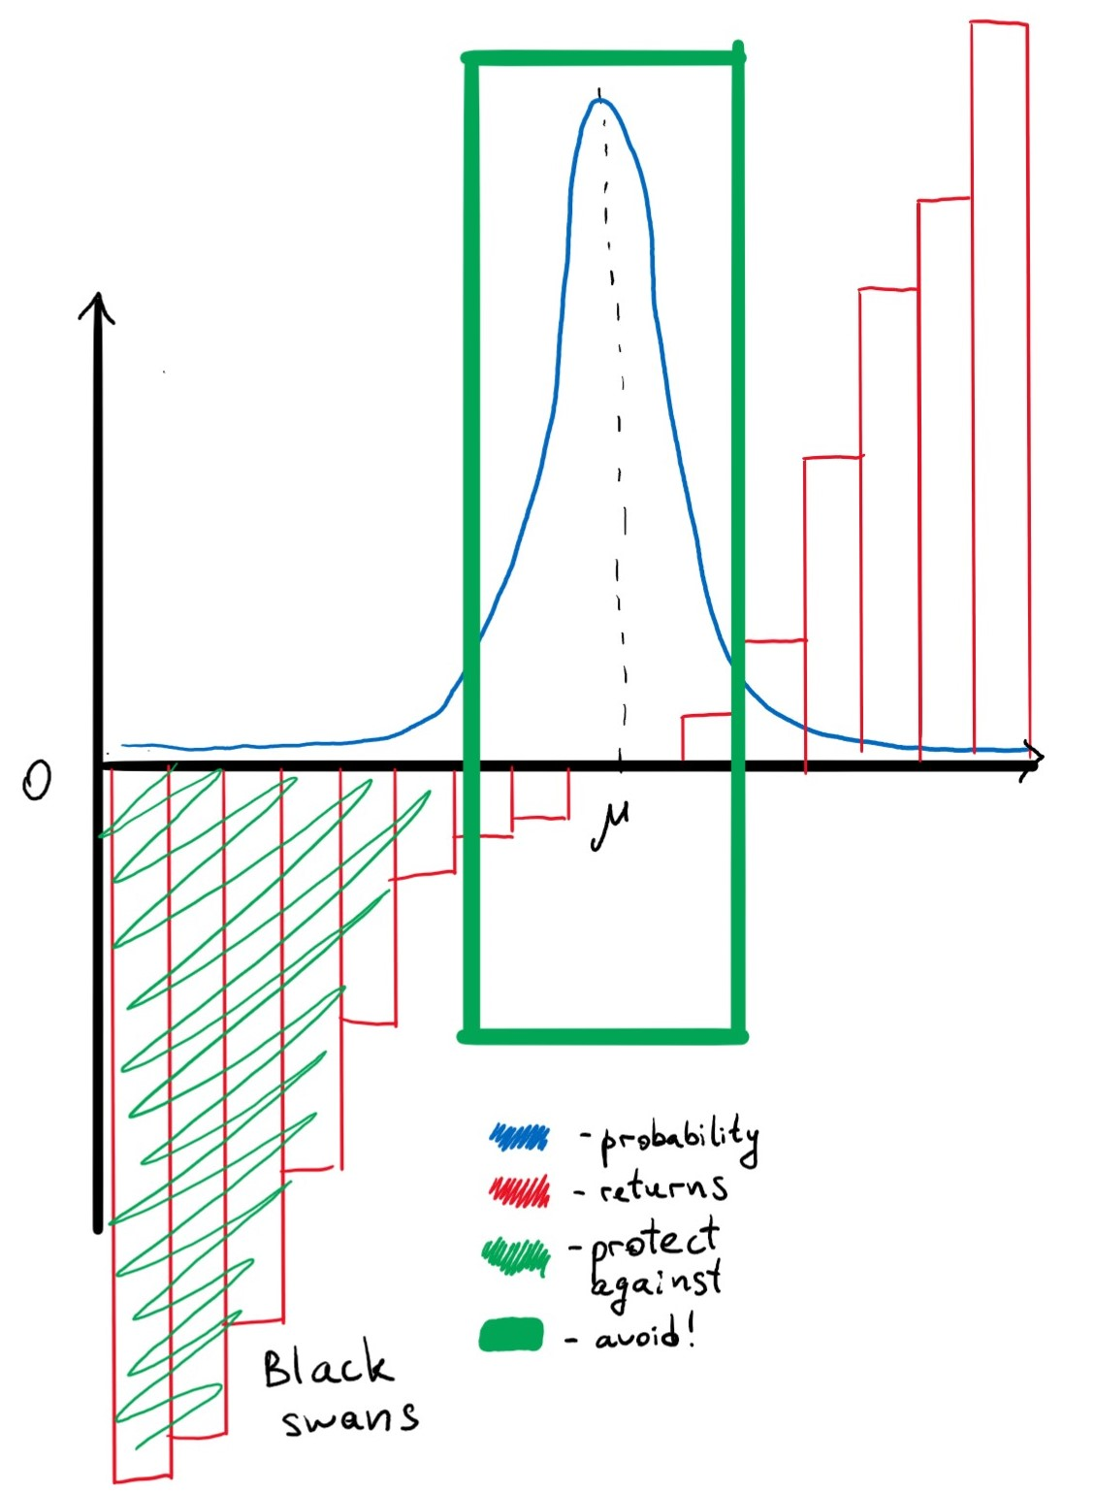
Background
What portfolio does

Slide 8
2. Asset Allocation

Slide 9
Asset allocation
Side | Ticker | Start date | % Weight | Side | Ticker | Start date | % Weight
Left side |  |  | 85% | Right side |  |  | 15%
TIPS | TIP | 2004 | 40% | Emerging Market ETFs | EMSH | 2014 | 10%
 | LTPZ | 2010 | 10% |  | EEM | 2004 | 10%
Short duration bond etfs | SHV | 2007 | 4.29% |  | VWOB | 2014 | 10%
 | VGSH | 2010 | 4.29% | High Yield Bonds | SPHY | 2013 | 10%
 | VCSH | 2010 | 4.29% |  | BSJO | 2017 | 10%
 | SHM | 2008 | 4.29% |  | HYG | 2008 | 10%
 | BSV | 2008 | 4.29% | Meme stocks | AMC | 2014 | 10%
 | BIL | 2007 | 4.29% |  | GME | 2003 | 10%
 | BWZ | 2009 | 4.29% | Crypto | GBTC | 2015 | 10%
Gold | GC=F | 2001 | 20% |  | ETHE | 2019 | 10%
Left side: paranoically safe
Right side: stupid risky
[A note about startups]

Slide 10
3. Calculations

Slide 11
Calculations
To what extent does mean and variance matter?

Slide 12
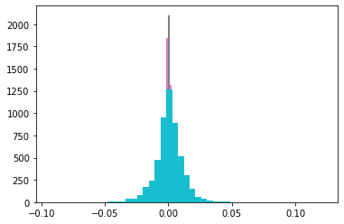
Calculations
Left side: (kurtosis, skewness)
TIP: (11.618, 0.197) # TIPS
LTPZ: (19.486, 0.623) |
SHV: (42.26, -0.261) # Short-term bonds
BIL: (46.507, 0.034) |
VGSH: (5.298, 0.082) |
VCSH: (161.789, -2.361) |
SHM: (89.933, -0.203) |
BSV: (71.291, -1.4) |
BWZ: (6.783, 0.223) |
GOLD: (5.417, -0.179) # Gold

Slide 13
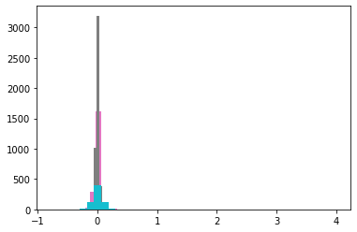
Calculations
Right side: (kurtosis, skewness)
EMSH: (17.629, -0.027) #Emerging
EEM: (17.521, 0.503) |
VWOB: (70.045, -4.157) |
SPHY: (25.735, -0.852) #HY
BSJO: (48.911, -1.432) |
HYG: (42.768, 0.828) |
AMC: (705.441, 21.01) #Meme stocks
GME: (191.304, 7.973) |
GBTC: (3.592, 0.558) #Crypto
ETHE: (330.916, 15.338) |

Slide 14
Calculations
Left Side:
Kurtosis = 27.20
Skewness = -0.113
Right Side:
Kurtosis = 145.39
Skewness = 3.97

Slide 15
Calculations
Left side: (mean, std)
TIP: (4.25, 6.08) # TIPS
LTPZ: (0.89, 0.35) |
SHV: (0.59, 0.53) #ST bonds
BIL: (6.83, 13.48) |
VGSH: (1.02, 1.04) |
VCSH: (2.68, 2.79) |
SHM: (1.85, 4.15) |
BSV: (2.18, 3) |
BWZ: (0.63, 7.53) |
GOLD: (10.78, 17.58) # Gold
Right side: (mean, std)
EMSH: (2.34, 6.62) # Emerging
EEM: (11.35, 28.74) |
VWOB: (4.23, 8.11) |
SPHY: (4.44, 7.96) # HY
BSJO: (4.33, 7.92) |
HYG: (5.68, 11.67) |
AMC: (61.12, 137.8) # MEME
GME: (46.86, 79.8) |
GBTC: (104.52, 93.39) #Crypto
ETHE: (274.42, 290.65) |

Slide 16
Calculations
Left side:
Mean = 4.62
Std = 7.38
Overall Portfolio:
Mean = 9.28
Std = 13.39
Kurt = 0.3
Skew = 39.02
Right side:
Mean = 51.19
Std = 67.25

Slide 17
4. Hypothesis testing

Slide 18
Hypothesis testing
Quick note:
Left side has 3049 degrees of freedom and starts from 2008, while the right side only has 675 and starts in 2019.
This is a limitation of trying to calculate cryptocurrency statistics, Ethereum specifically.
Because of that, the portfolio DataFrame will only have 675 degrees of freedom as well.

Slide 19
Hypothesis testing
Is the left side’s mean return equal to 0?
Is the right side’s return equal to 0.009?
Are variances of both sides of the portfolio equal?
Is the left side’s variance equal to 0?
Is the right side’s variance equal to 1.198?
Are mean returns from both sides of the portfolio equal?
Is there a correlation between the sides?

Slide 20
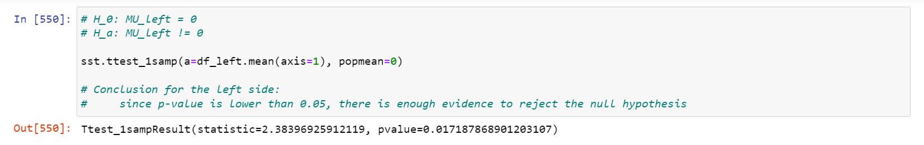
Hypothesis testing
1. Is left side’s mean return equal to 0?

Slide 21
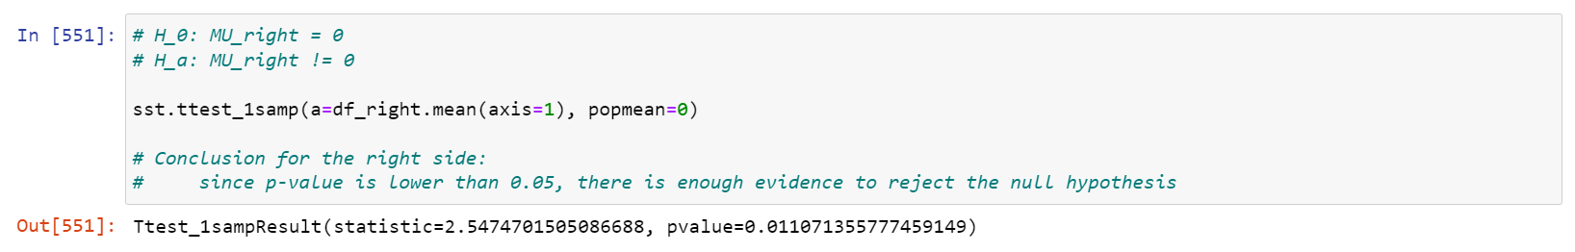
Hypothesis testing
2. Is right side’s mean return equal to 0?

Slide 22
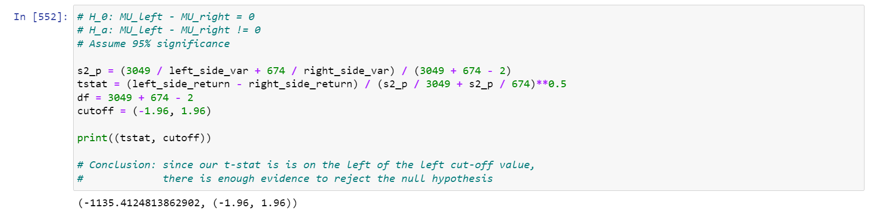
Hypothesis testing
3. Are mean returns from both sides of the portfolio equal?

Slide 23
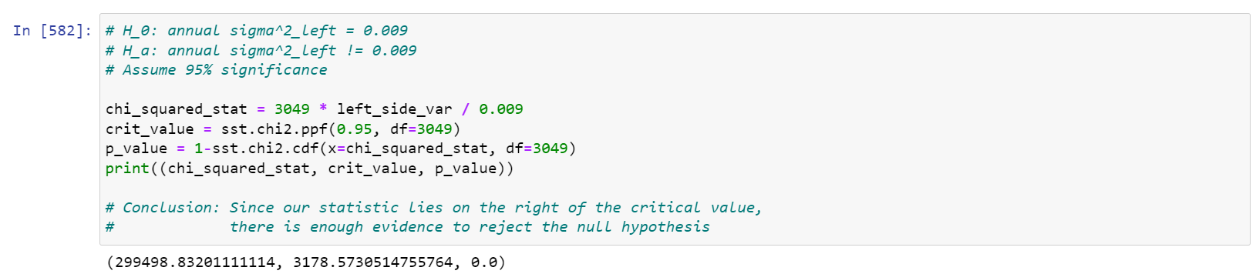
Hypothesis testing
4. Is left side’s variance equal to 0.009?

Slide 24
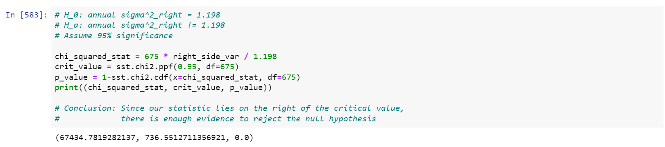
Hypothesis testing
5. Is right side’s variance equal to 1.198?

Slide 25
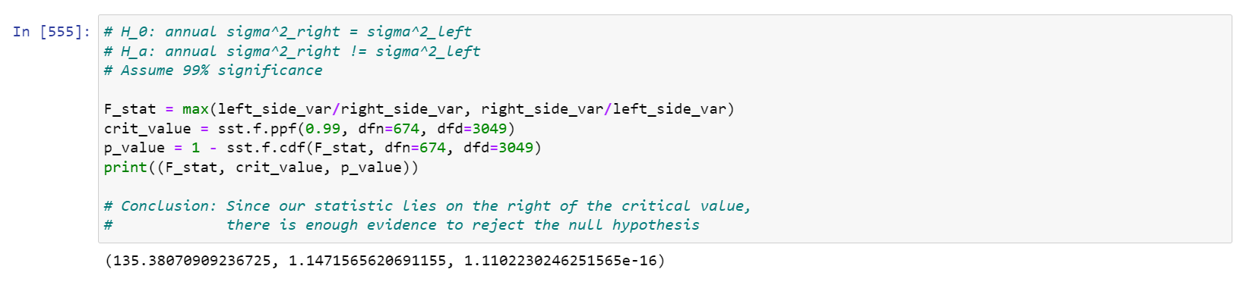
Hypothesis testing
6. Are variances of both sides of the portfolio equal?

Slide 26
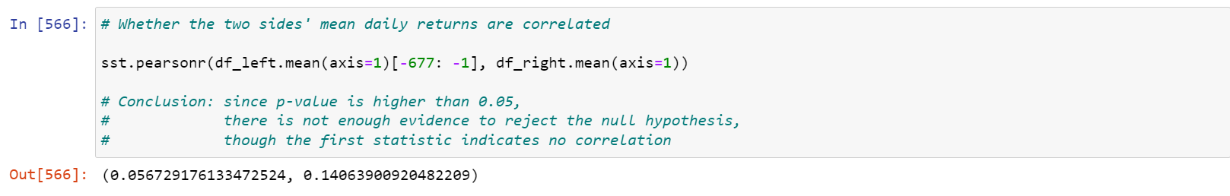
Hypothesis testing
7. Correlation between sides? (Test assumes normal distribution)

Slide 27
5. Conclusion

Slide 28
Conclusion
Barbell portfolio is antifragile:
Protection against negative Black Swans
Exposure to positive Black Swans
Previous point in English:
Worst case scenario: you lose a bit (not bankruptcy)
Best case scenario: sky is limit to the upside
Hard to interpret results because of kurtosis and skewness
But we don’t have to!

Slide 29
Thank you!

